Slide 1
Personalized Health Monitoring Assistance
Wordh Ul Hasan, Mohammad Sultan Khaja, Saif Ahmed &
Mohammad Monirujjaman Khan (Mentor) Department of Electrical & Computer Engineering, North South University wordh.u.hasan@ieee.org, mohammads.k.92@gmail.com, saif.ahmed@northsouth.edu

Slide 2
Introduction
Chronic diseases has been a matter of great concern.
This project tries to tackle the problems associated with chronic diseases, especially the ones that come with old age and sustain for a long period of time.
Health Care services to Rural Areas

Slide 3
Proposed Solution
24 hour assistance to the patient at home.
Basic determinants will be monitored.
Store the data to a web server every minute.

Slide 4
Proposed Solution (Continued)
Close relatives and doctors will access to the server
A switch which enables the patient to send an alarm to his relatives manually in case of any discomfort.

Slide 5
Parameters
ECG
NIBP
SPO2
RESP
Body Temperature
PR

Slide 6
Technologies in use
Android Studio
Laravel 5.3
Bluetooth

Slide 7
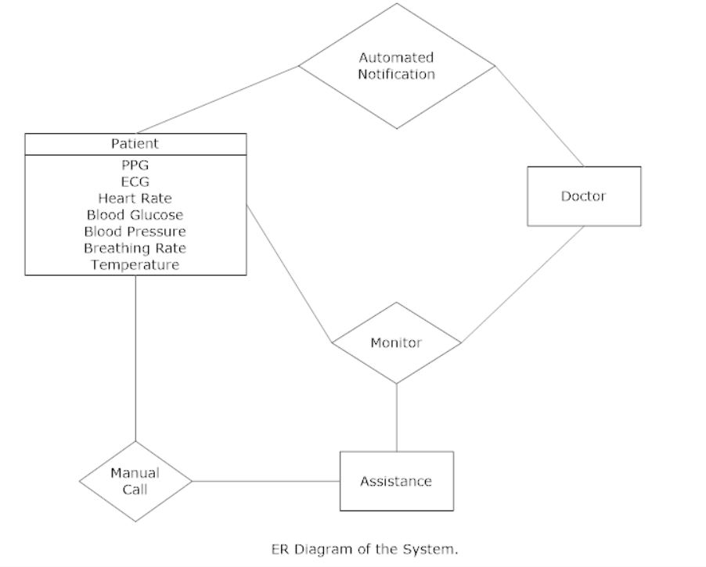
System Architecture

Slide 8
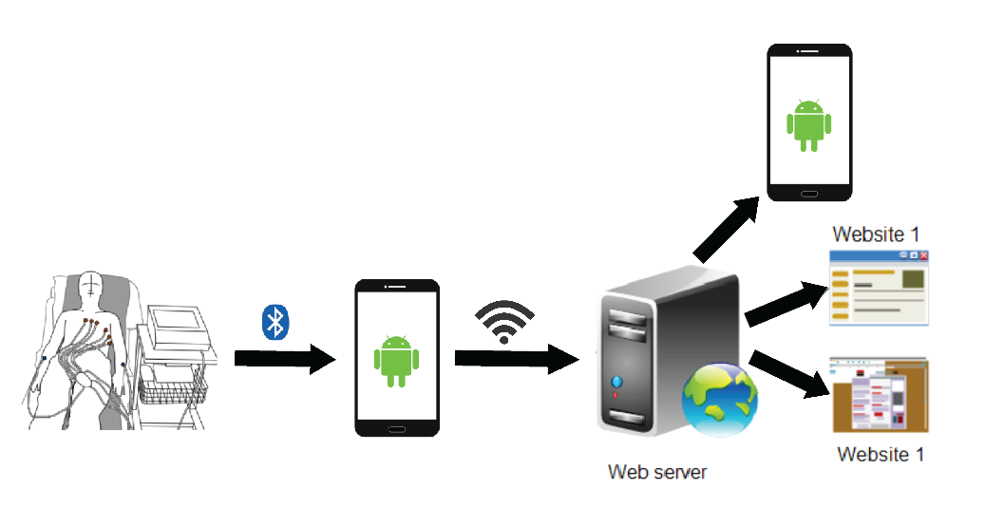
Communication

Slide 9
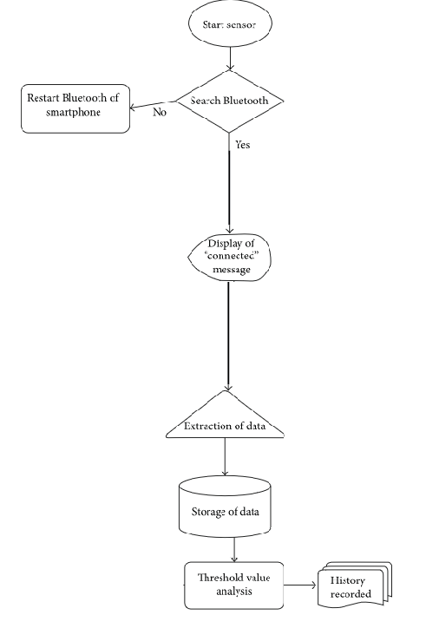

Slide 10
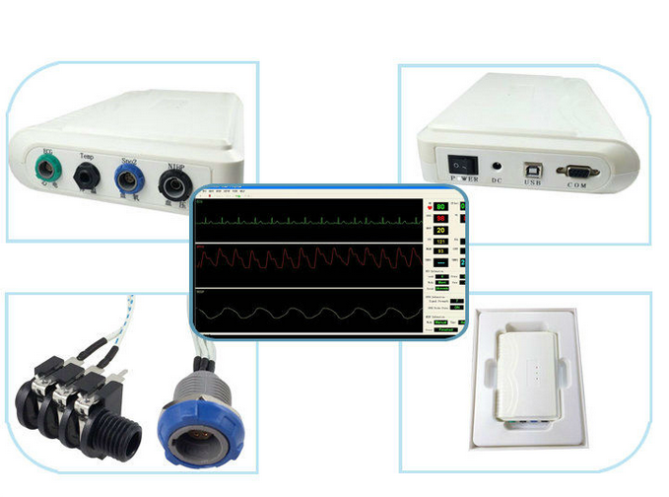
Device –PM6750

Slide 11
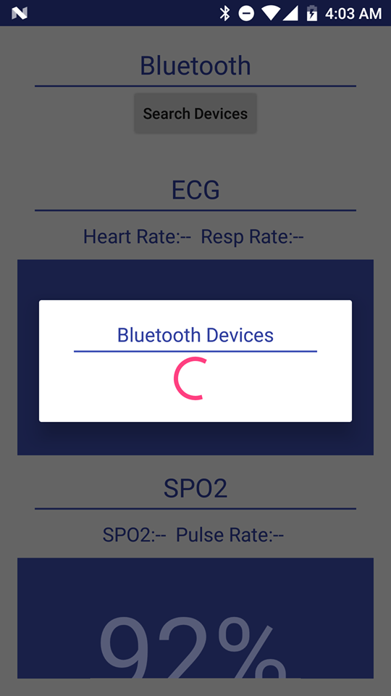
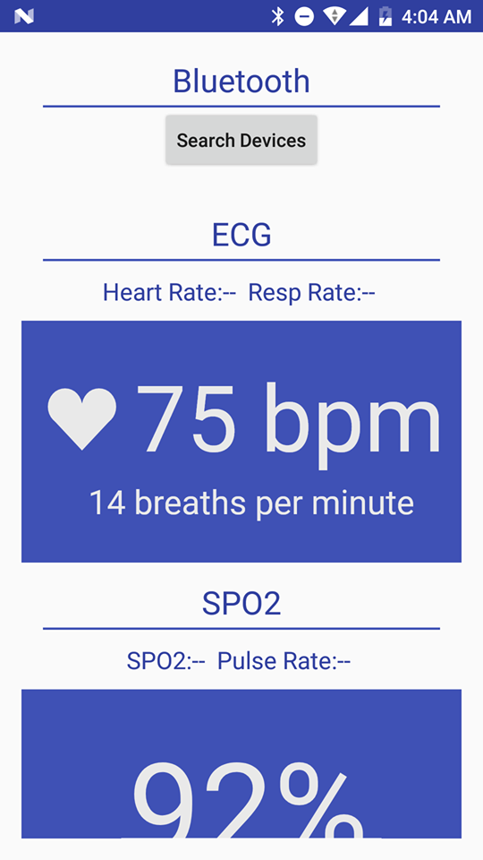

Slide 12
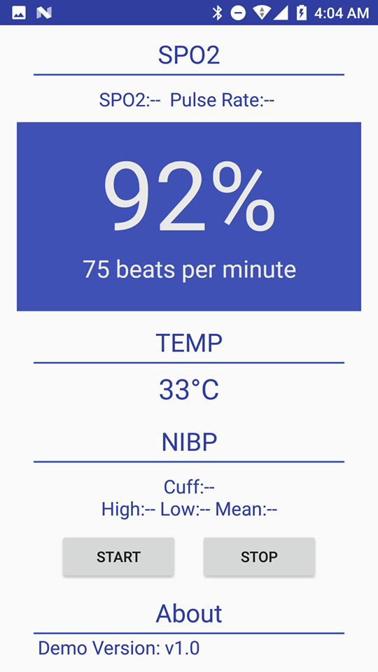

Slide 13
Cost:
PM 6750 – 29,400 BDT
Server – 2000 BDT
Total- 31,400 BDT

Slide 14
Conclusion
In conclusion, increasing rate of chronic diseases in aging population is becoming a serious concern due to lack of sufficient facilities and extremely high cost.
The situation is even worse for the people residing in remote areas far from medical facilities as delay in diagnosis and treatment may lead to death.
Timely diagnosis and treatment can solve these issues to a great extent. The advancements in wireless communications and wearable sensor technology open up the opportunity of real-time healthcare monitoring systems.

Slide 15
The system will be able to extract several cardiac parameters such as heart rate, blood pressure, and temperature of multiple patients simultaneously.
The extracted data is being transmitted to Android handheld device using Bluetooth low energy which is then transmitted to web application for further processing.
Web application processes received data to show medical status of the patient along with personal information such as age, gender, address, and location on web interface.
An alarming system based on threshold values has also been designed which sends alert message to the doctor in case of abnormalities such as arrhythmia, hypotension, hypertension, fever, and hypothermia.

